Slide 1
Quality in Software engineering

Slide 2
Main points to be discussed
What is quality software?
How quality matters in software development?
How to ensure quality software?
Benefits of maintaining quality software.

Slide 3

AIMAN JAVED (f2022266913) HIFZA MUNAWAR (F2023266309) NOOR-UL-HUDA (F2023266853) TEHREEM ARSHAD (F2023266948)

Slide 4

What is quality software?
What is quality?
We said that a thing exhibit's quality when it fulfills users demand
The Cambridge Dictionary defines quality as "how good or bad something is," emphasizing the standard of a product or service.
Cambridge Dictionary

Slide 5
What is quality software?
Software Quality shows how good and reliable a product is
https://www.geeksforgeeks.org/software-engineering-software-quality/#what-is-software-quality
software quality is a multifaceted concept that plays a vital role in the success and longevity of software products.
2. Google Chrome
Why it stands out:
High efficiency in rendering web pages.
Regular updates for security and performance improvements

Slide 6

Importance of quality software
High software quality is crucial as it leads to increased user satisfaction, reduced maintenance costs, and enhanced reliability and performance. Conversely, poor software quality can result in system failures, security vulnerabilities, and increased costs due to defect correction and system downtime

Slide 7
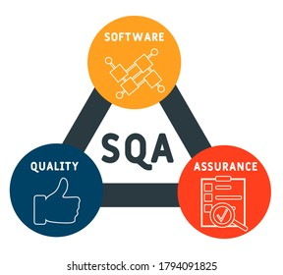
Why quality matters in software development?
1. Reliability
High-quality software performs its intended functions consistently without failures. Reliable software builds user trust and reduces the risk of errors that could lead to significant issues (Incorrect Outputs, Data Loss, Poor User Experience,etc).
GeeksforGeeks
2. Maintainability
Quality software is easier to update and modify. This means that when new features are needed or bugs are found, changes can be made quickly without introducing new problems.
GeeksforGeeks

Slide 8

3. User Satisfaction When software is user-friendly and meets expectations, users are more satisfied. This leads to positive reviews and recommendations, which are vital for the software's success. Medium 4. Cost Efficiency Investing in quality during development can save money in the long run. Fixing issues after release is often more expensive than addressing them early on. Mescius Developer 5. Competitive Advantage Delivering high-quality software distinguishes a company in the marketplace, enhancing its reputation and providing a competitive edge. Quality products are more likely to meet customer needs and stand out among competitors. Medium

Slide 9
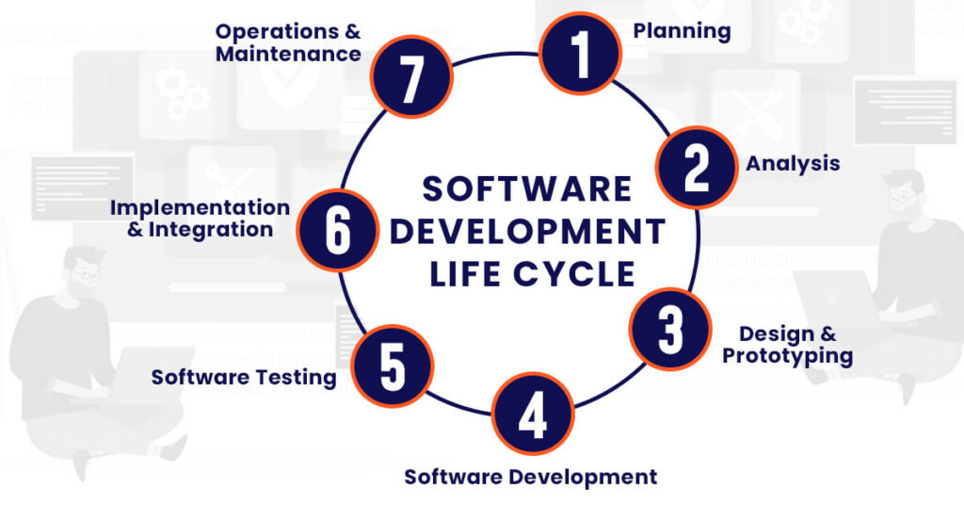
How to ensure Quality Software?
Clear Requirements & Specifications
Ensure detailed and well-understood requirements to meet user needs.
Use use-cases to define functional and non-functional requirements.
Choose the Right SDLC Methodology
Agile or Waterfall: Choose based on the project type. Agile supports flexibility, while Waterfall is more structured.
Code Reviews & Pair Programming
Peer reviews catch defects early, and pair programming ensures real-time collaboration to improve code quality.

Slide 10

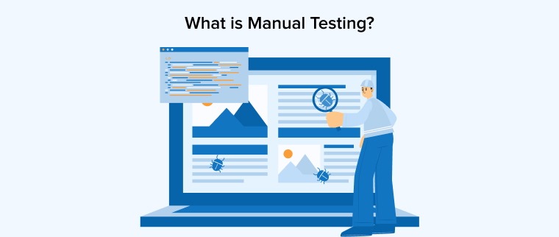
Automated Testing
Implement unit, regression, and integration tests to catch bugs early.
Use Continuous Integration (CI) tools to automate testing with every code change.
Manual Testing
Include exploratory and user acceptance testing (UAT) to ensure real-world usability and correctness.
Performance Testing
Conduct load and stress testing to verify the software can handle expected and unexpected usage.
7. Refactoring & Maintainable Code
Write clean, maintainable code and refactor regularly to reduce technical debt.

Slide 11

8. Version Control & Configuration Management
Use Git for version control and maintain consistency across different environments.
9. Continuous Monitoring & Feedback
Use monitoring tools post-deployment to identify issues and gather user feedback to improve quality.
10. Quality Metrics & Audits
Track defect density, code coverage, and other metrics to measure software quality.
Regular audits ensure adherence to standards and identify areas for improvement.

Slide 12

Benefits of software quality:
1. Increase User Productivity
• High-quality software ensures that users can efficiently complete their tasks without interruptions caused by bugs or poor design.
• Features that work as intended and are user-friendly enhance productivity and reduce frustration.
• Test Dev Lab
2. Market Reputation
• Delivering consistently high-quality software establishes your organization as reliable and professional.
• Positive reviews and word-of-mouth marketing further solidify the company’s position in the industry.
• Tatvasoft

Slide 13
3. Better Team Productivity
• Quality processes reduce rework and debugging time, allowing teams to focus on innovation and delivery.
• Developers and testers work cohesively when quality is emphasized throughout the lifecycle.
• Indeed
4. Adaptability to Changing Requirements
• High-quality software is designed to be modular and maintainable, making it easier to incorporate new features.
• As markets evolve, adaptable software helps businesses remain competitive and meet new demands quickly.
Software Improvement Group

Slide 14
5. Greater Stakeholder Confidence
Quality software ensures reliability, meeting stakeholder expectations.
Investors and customers are more likely to trust an organization that prioritizes quality, fostering long-term relationships.
Simplilearn

Slide 15

thank you

